Slide 1

Controlling Volume with Hand Gestures using a Webcam M1-Webcam Input and Hand Detection Module
Mentor:Dr. D.Bhanu Prakash Presented by:Oviya K P

Slide 2
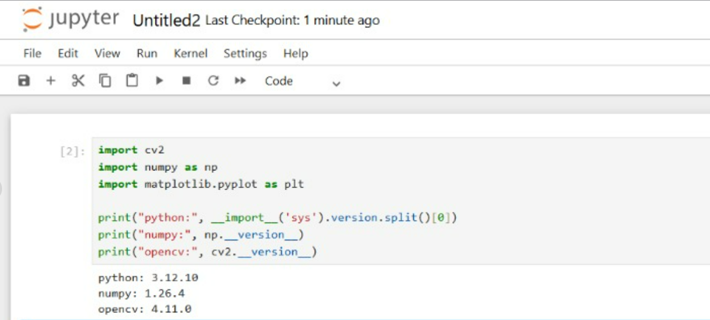
VERIFICATION

Slide 3
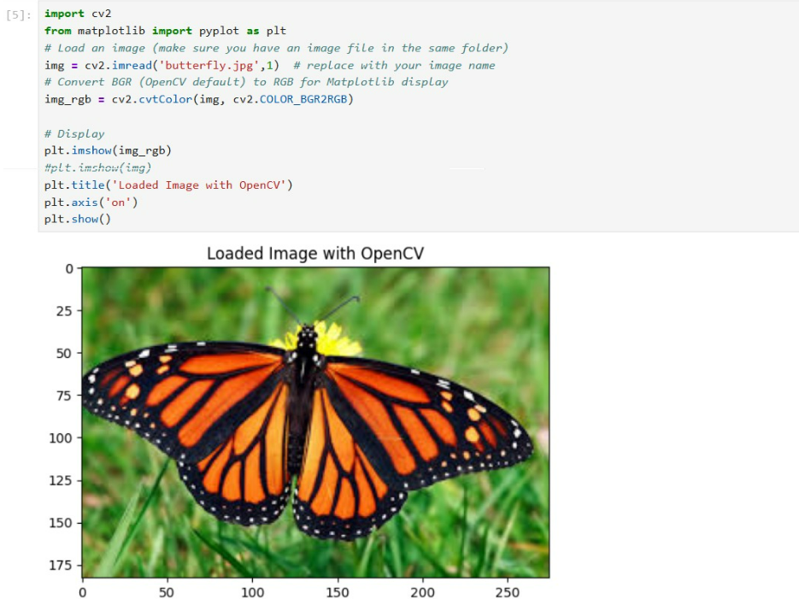
LOAD AND DISPLAY IMAGE

Slide 4
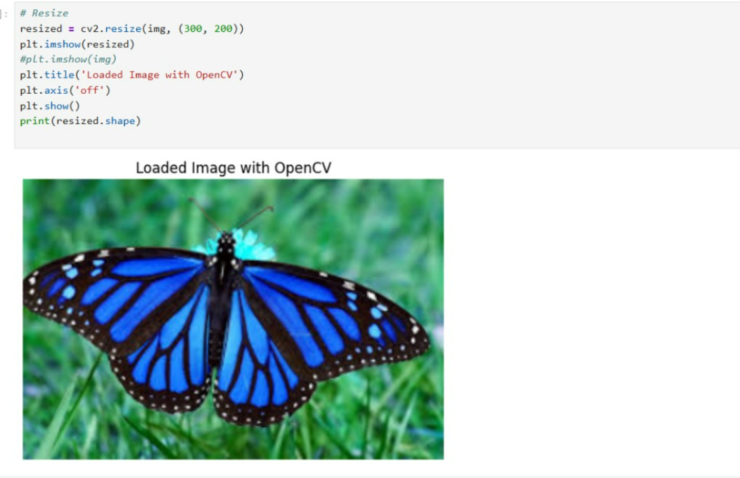
RESIZE IMAGE

Slide 5
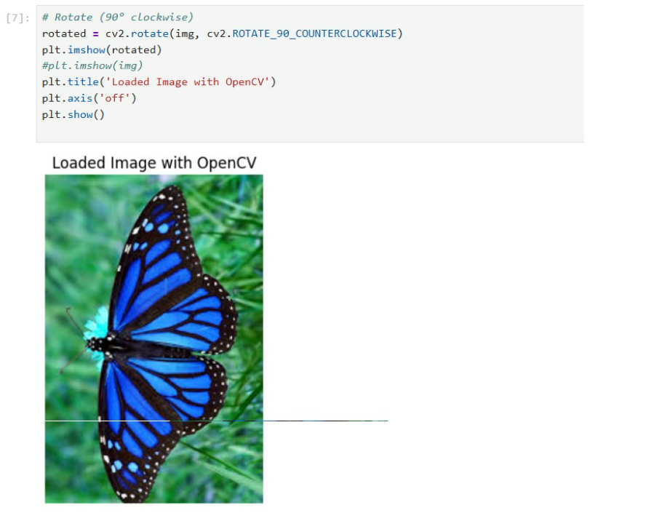
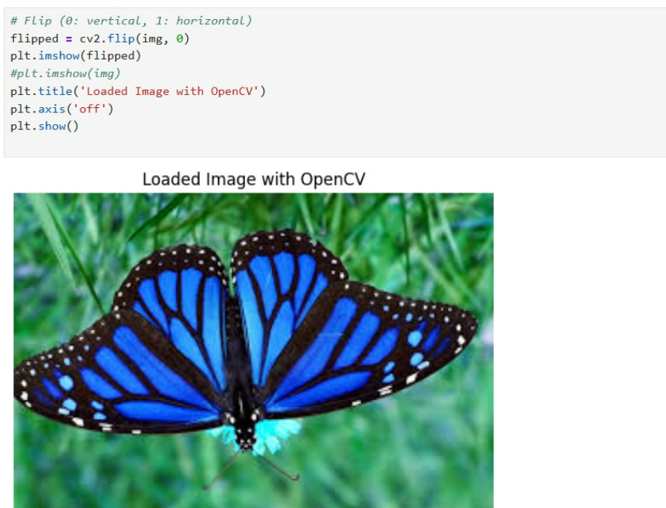
ROTATE AND FLIP
Rotate Counter Clockwise
Vertical Flip

Slide 6
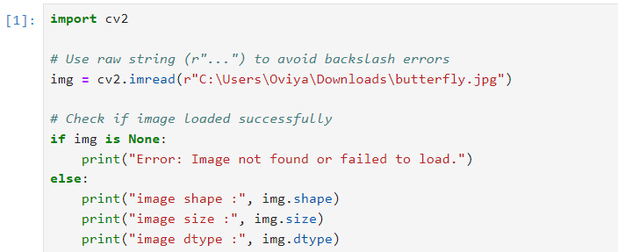
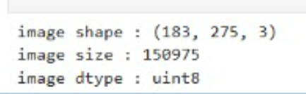
DISPLAY IMAGE INFORMATION

Slide 7
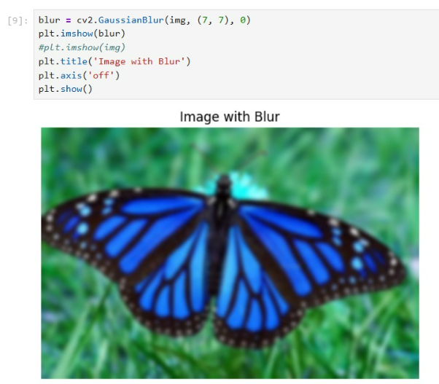
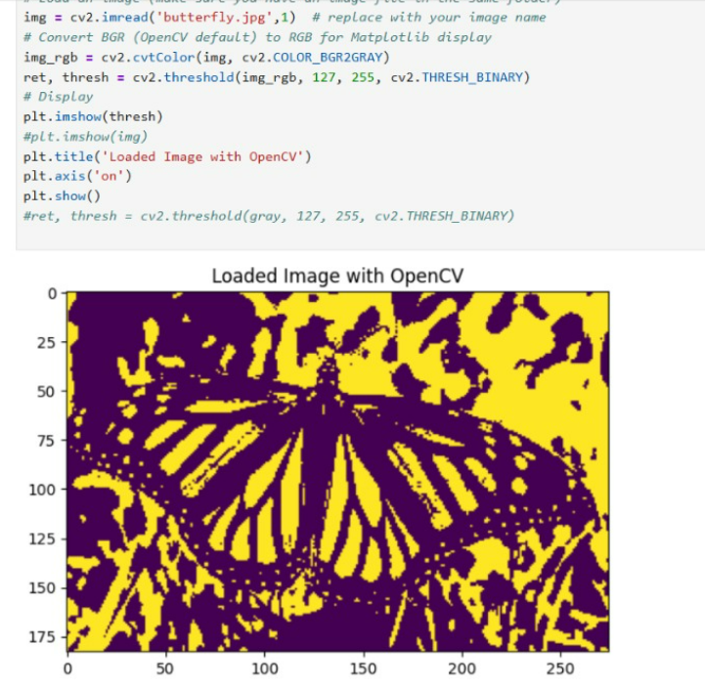
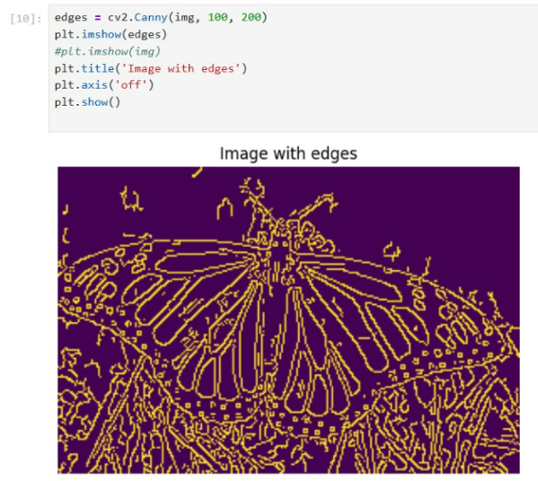
IMAGE PROCESSING TECHNIQUES
Blur
Thresholding
Edge Detection

Slide 8
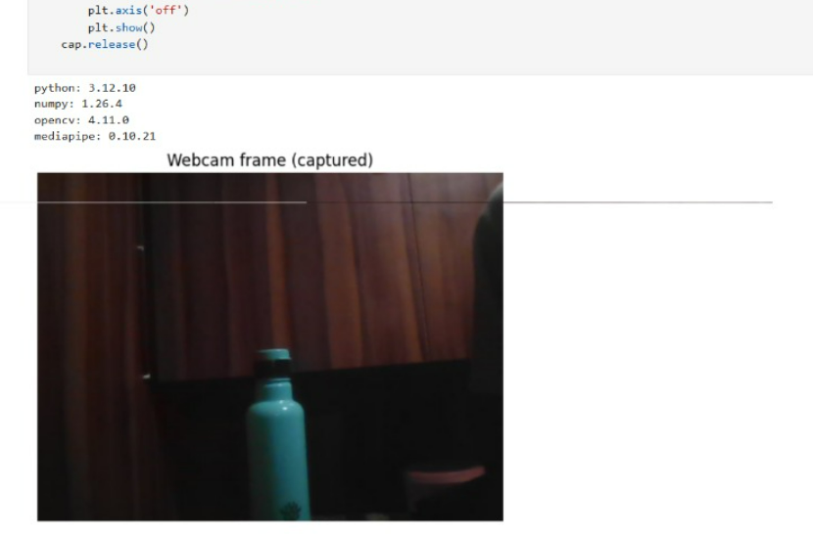
WEBCAM CAPTURE

Slide 9
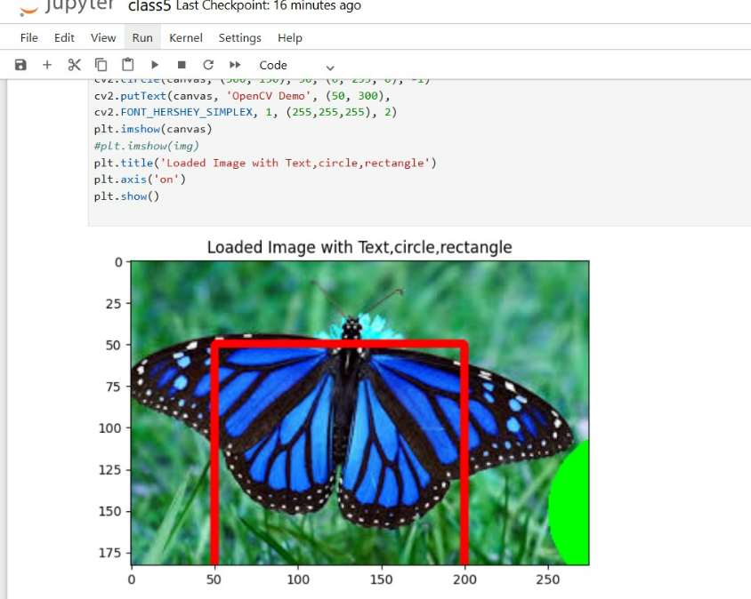

Slide 10
Thank you

